Slide 1
Words and their analyser

Slide 2
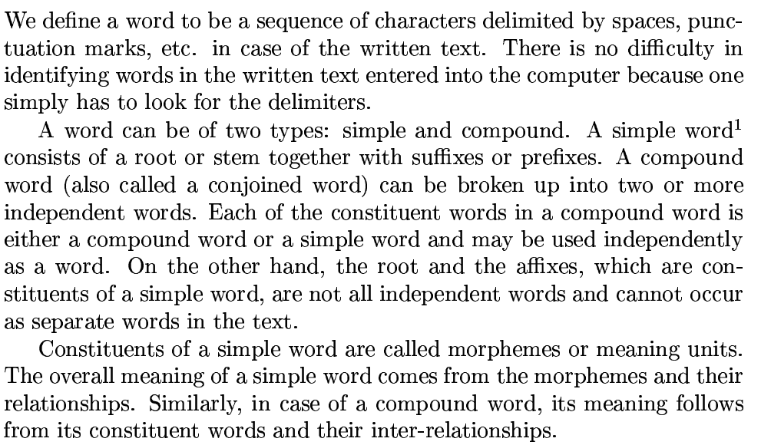
Word

Slide 3

Simple Word- can not
Compound Word- can’t

Slide 4

Generator

Slide 5

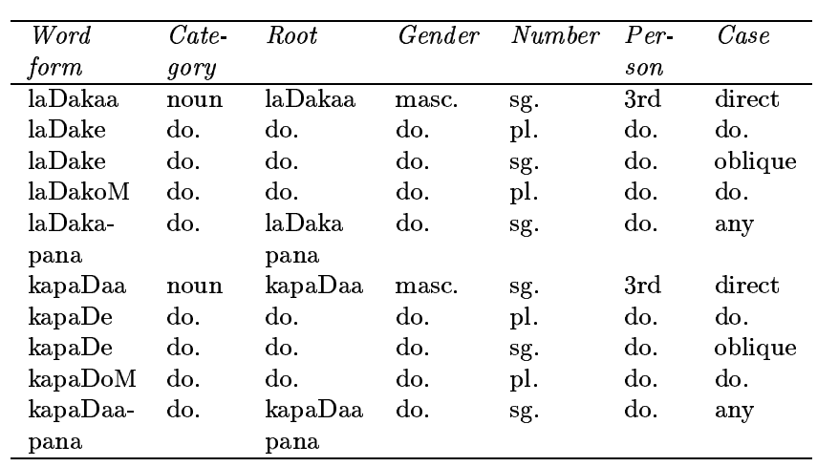
Why Morphological Analyzer

Slide 6
Issues in Lexicons-
Wasteful of memory space
Fail to represent linguistic Generalisation- to predict unknown word feature value
Deal to store Morphologically rich and productive language due to availability of infinite words
So solution is Morphological Analyser

Slide 7

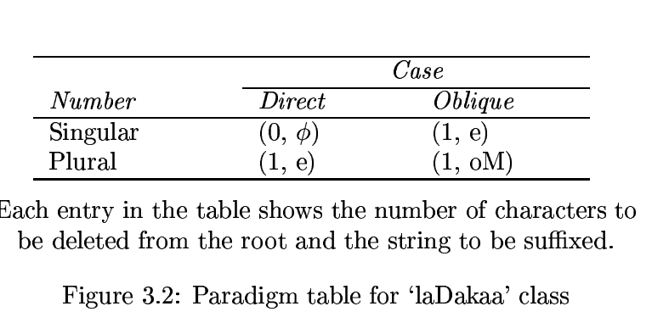
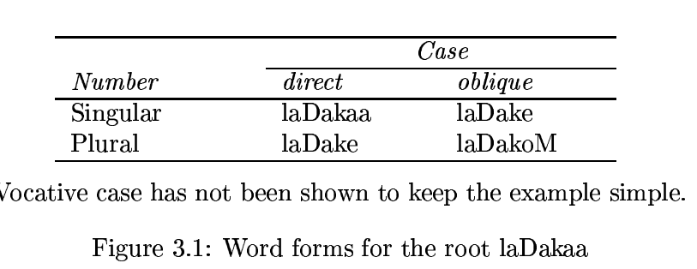
Morphological Generation using Paradigms

Slide 8
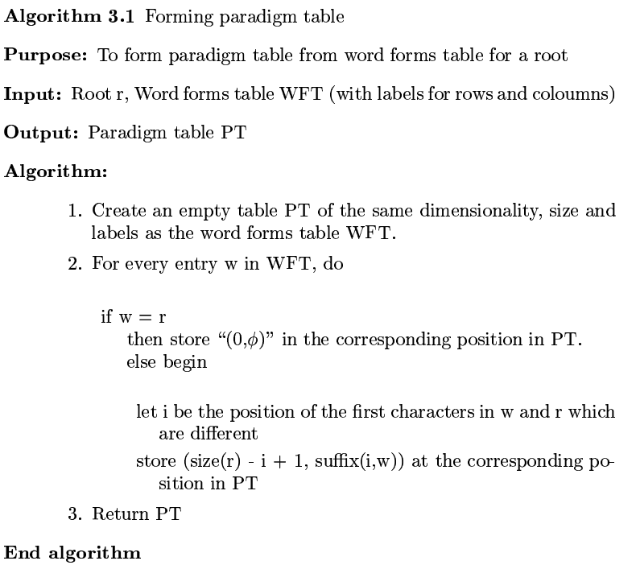
Algorithm – paradigm table

Slide 9
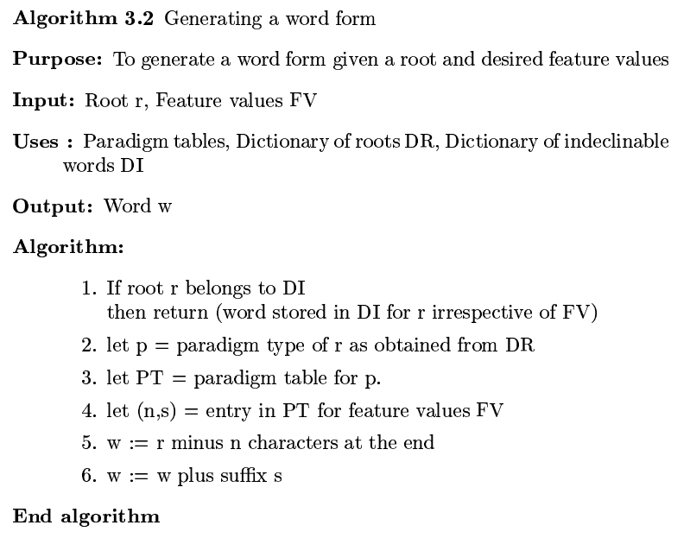
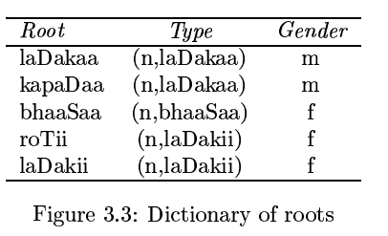

Slide 10

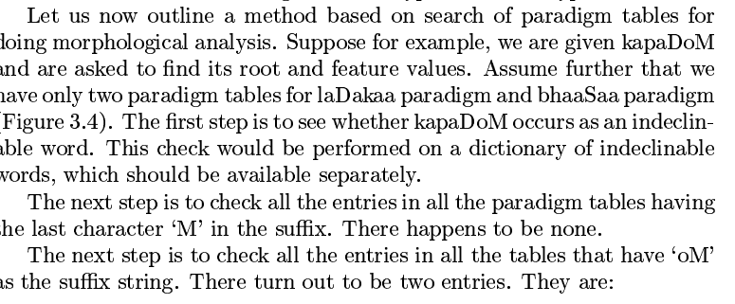
Morphological Analysis using Paradigms

Slide 11
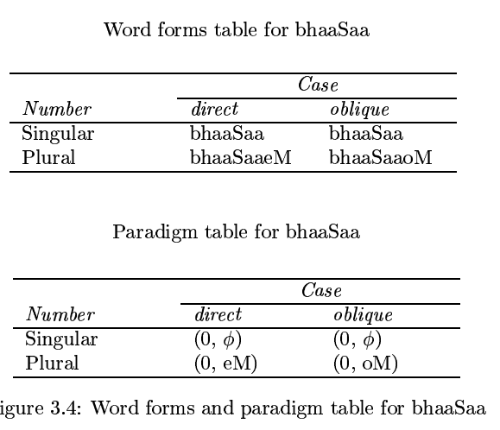


Slide 12
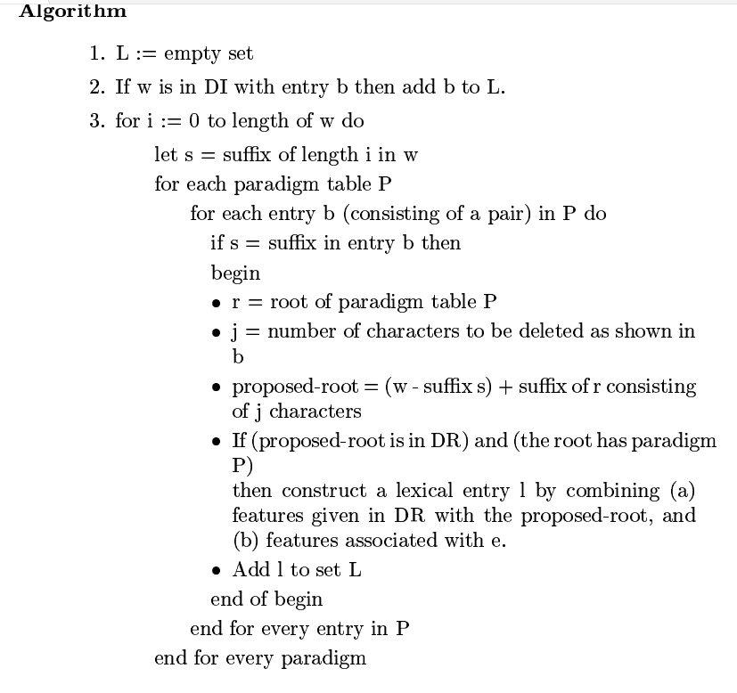
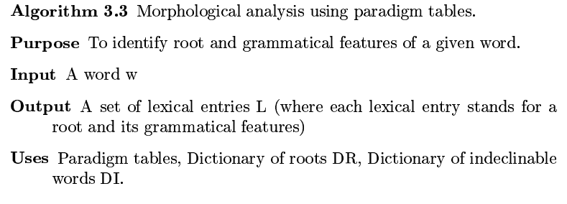
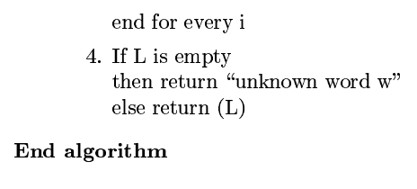

Slide 13
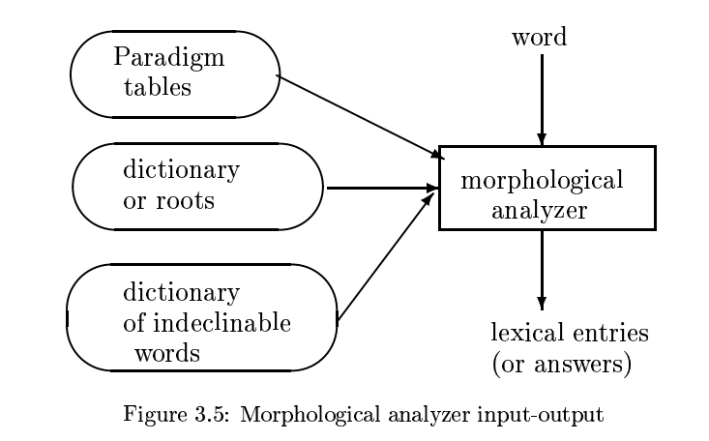

Slide 14
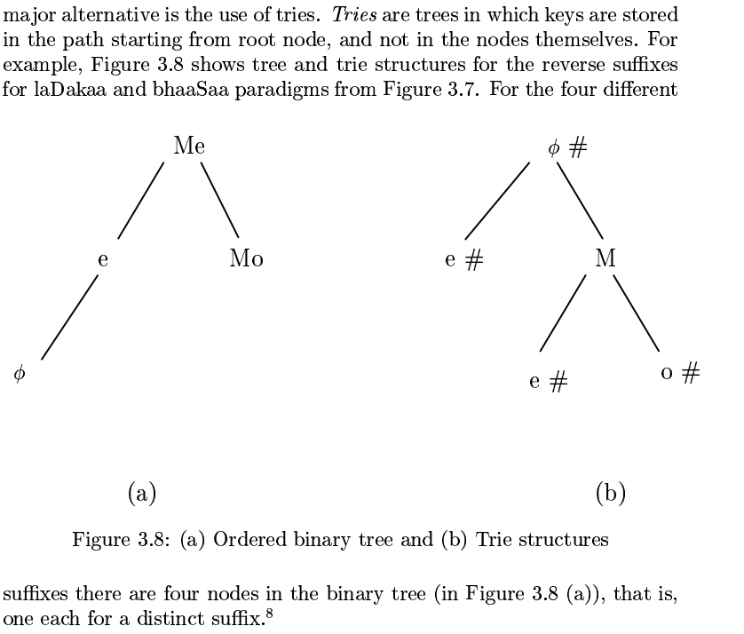

Morphological Analyzer-tree structure

